Slide 1
ArcGIS Essentials
Basics of ArcGIS from Online Tutorials. MUST be viewed as a slideshow to see the process flow. Run it Auto or with the timings turned off. (SlideShow | uncheck Use Timings)
Ref: https://learn.arcgis.com/en/projects/get-started-with-arcgis-online/
ACKNOWLEDGEMENT
This presentation is derived from the above page, with navigation and explanations added to simplify the learning process. While the presentation in its entirety remains the property of NCI, the knowledge base and some graphics in the above URL are owned by ESRI
Copyright © 2019-2020 by National Computational Infrastructure, Canberra, ACT, Australia. Author: Dr. Arapaut V Sivaprasad.
Created: 8 January, 2018; Last edited: 9 Mar, 2020

Slide 2
Contents
This tutorial aims to give basic understanding on the following:
Introduction to ArcGIS Online
Sign Up and Sign In
Basic usage
Create a map
Change styles
Add demographic data
View attribute table
Style the layer with attribute
Style with normalized data
Customise the pop-up
Create a web app
Adding GSKY Web Map Service
Advanced usage
TL;DR
ArcGIS Online and Desktop Pro require an Institutional or Public licence.
Slides 3-15 describe general use and analyses with ArcGIS
Slides 16-18 describe the default WMS feature of GSKY.
Slides 19-25 describe the use of KML with GSKY.
Slides 26-27 give KML limitations in ArcGIS.
Slides 28-29 give comparisons of ArcGIS versions.
Slides 30-31 describe ArcGIS Explorer and GSKY
Slide 31 describes ArcGIS Explorer for Mac.

Slide 3
Lesson Plan
Create a map | Create a map showing evacuation routes in Houston. | 10 minutes
Identify spatial patterns | Use smart mapping and pop-ups to determine areas with low vehicle ownership. | 20 minutes
Create an app | Configure a web app to share your findings with others. | 15 minutes

Slide 4
Summary
In this tutorial, you will learn to create a map, add layers, add demographic data, etc. as shown below. This is a beginner’s lesson to get started with ArcGIS, and does not cover all options and advanced functions.
‘ArcGIS Online’ is used here. ‘ArcGIS Pro Desktop’ can achieve the same result, but the process is different.
Sign up and/or Sign in
Create a map
Click ‘Map’ and zoom to an area
via mouse wheel
Searching for ‘Houston’
Add a layer
‘Hurricane Evacuation Routes’
Change the base map and line styles
Save map
Set map for share
Add demographic data
Add the layer, ‘Houston Demographics by Census Tracts’ to the map
View the attribute tables
Style the layer with attribute data
Normalise the style data
Customise the Pop-up
Create a web App
Copy the public URL of the web app.
Next: Details

Slide 5
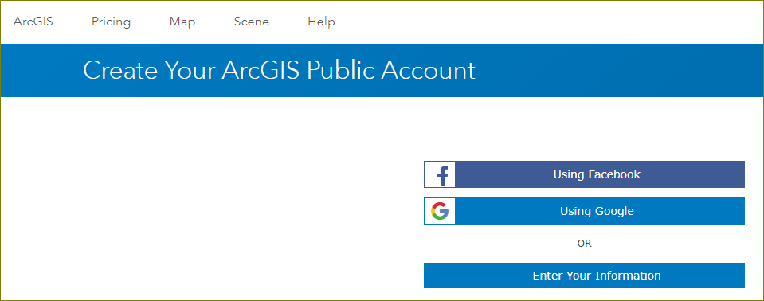
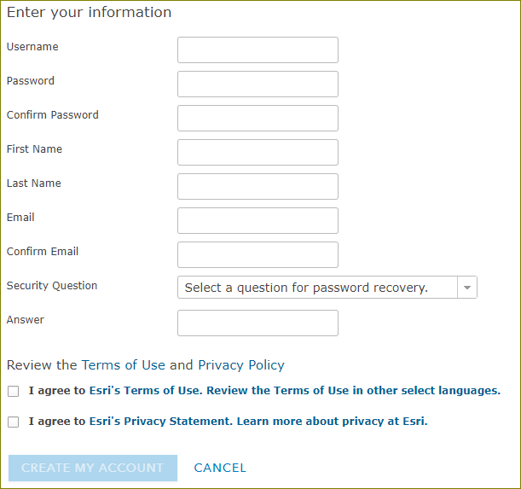
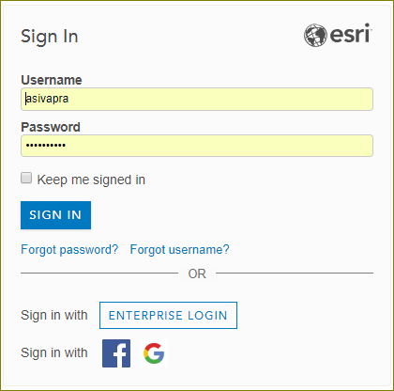
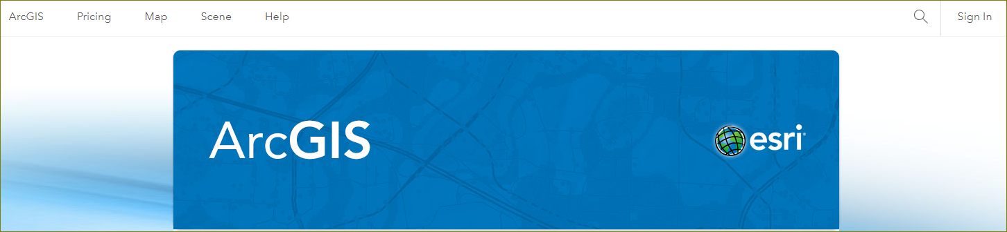
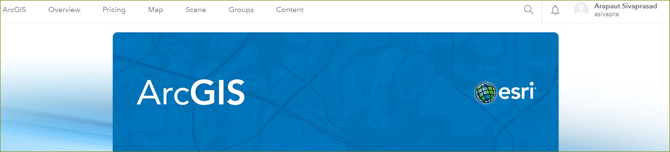
Sign Up and Sign In
In this lesson, you'll create a map that shows hurricane evacuation routes in Houston, Texas. First, you'll create a new map and locate Houston, Texas. Then, you'll add a map layer that shows evacuation routes. Lastly, you'll change the way your map and layers look to better display the data.
If you don't have an ArcGIS account, you can sign up for a free public account or an ArcGIS free trial.
Sign Up: https://www.arcgis.com/home/createaccount.html
Sign In: https://www.arcgis.com/home/index.html
Next: Create a Map

Slide 6

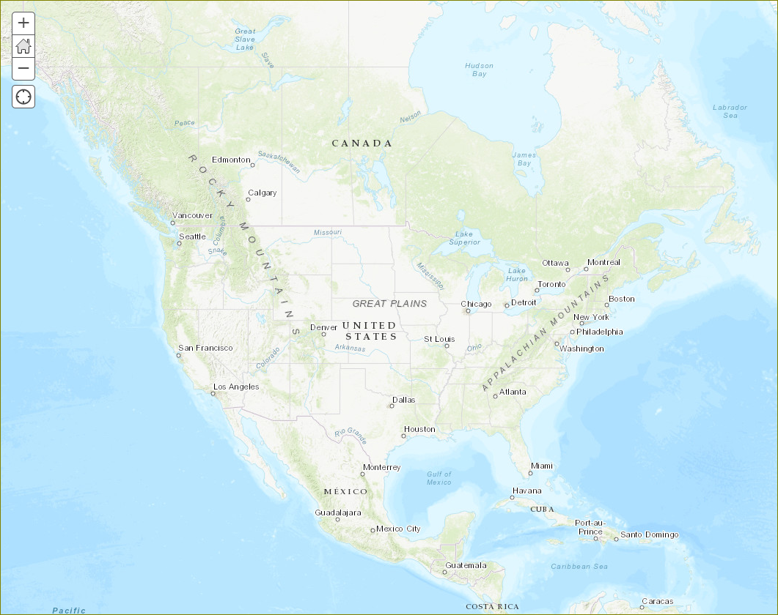
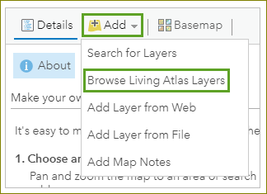
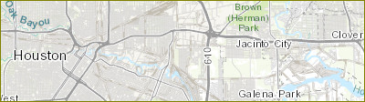
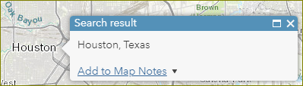
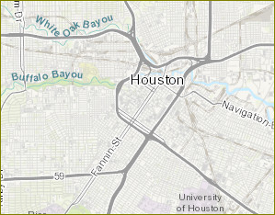
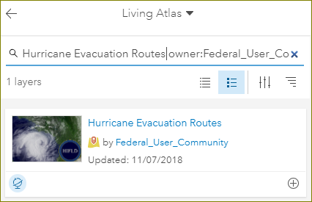
Create a Map
1. Click ‘Map’ and zoom to USA.
2. Search for ‘Houston’.
3. Dismiss the ‘Search result’ box.
4. Zoom until ‘Buffalo Bayou’ is visible.
5. Click ‘Add | Browse Living Atlas Layers’.
6. Type in ‘Hurricane Evacuation Routes owner:Federal_User_Community’.
7. Click the Add button (+)
Next: Change Styles

Slide 7
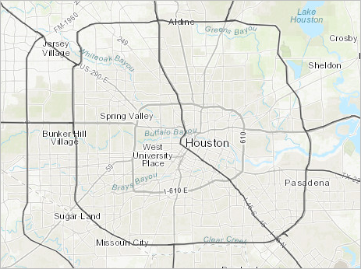
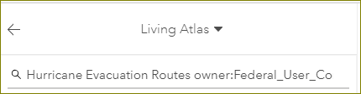
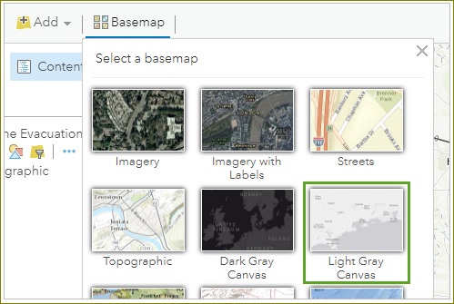
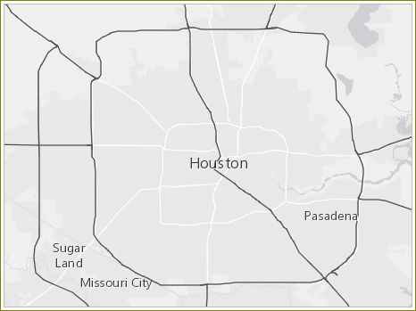
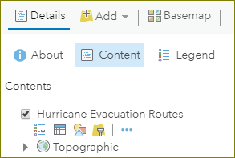
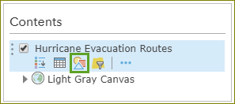
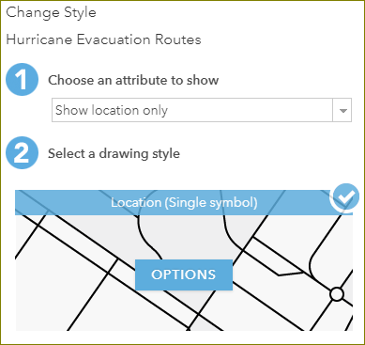
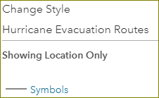
Change Styles
In the previous slide we added the layer showing the hurricane evacuation routes. To make them stand out on the map, we will now change the styles of the routes and the underlying map.
1. The layer showing the routes has been added to the map.
2. Click the back arrow and then on ‘Content’ to see the added layer names.
3. Click ‘Basemap’ to change the map to a light background.
4. In the Contents pane, point to the ’Hurricane Evacuation Routes’ layer and click the ’Change Style’ button.
5. Click ‘OPTIONS’
6. Click ‘Symbols’
Continued…

Slide 8
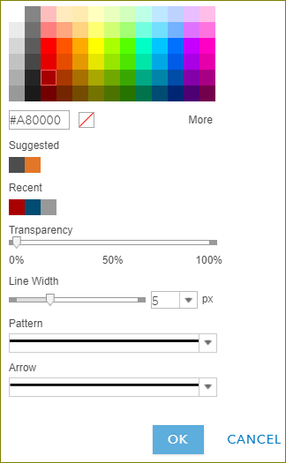
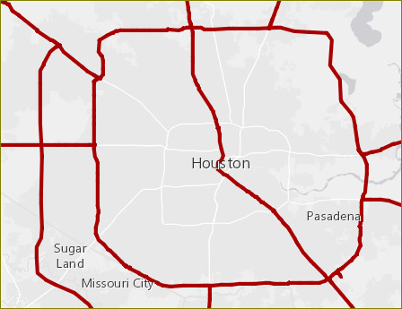
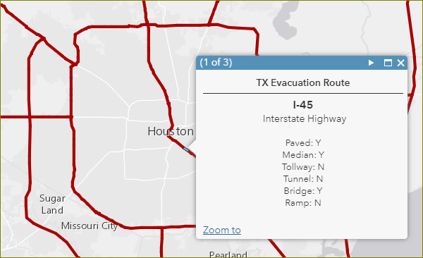
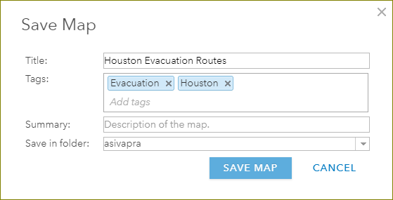
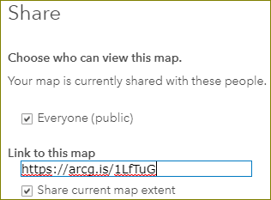
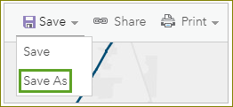
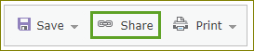
Change Styles (cont.)
1. Choose a color
2. Choose a line width
3. Click OK
4. Click anywhere on the route
5. Save the map
Next: Add Demographic Data
6. Share the map

Slide 9
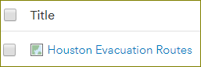
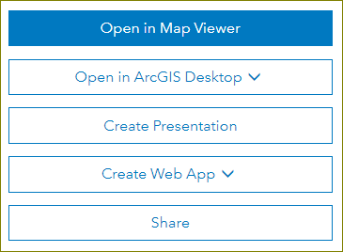
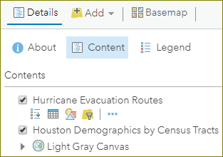
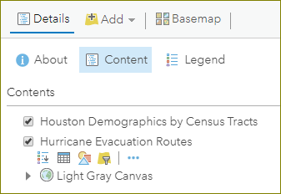
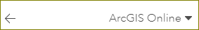
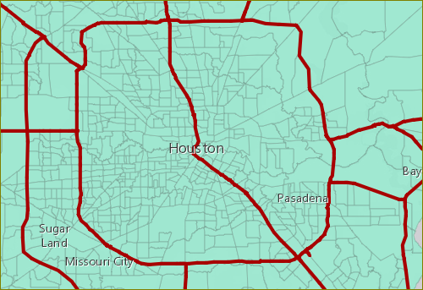
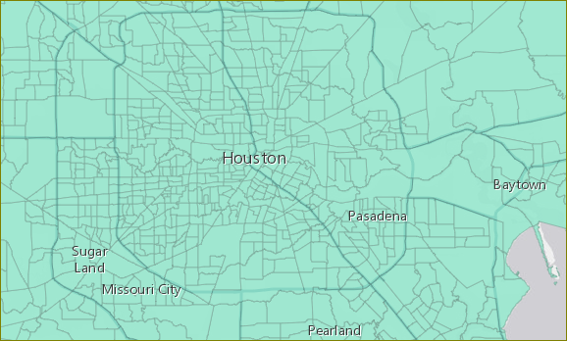
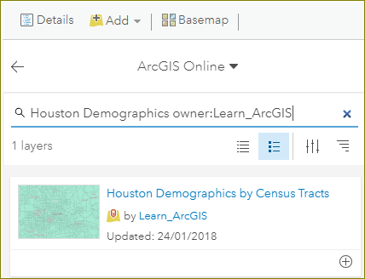
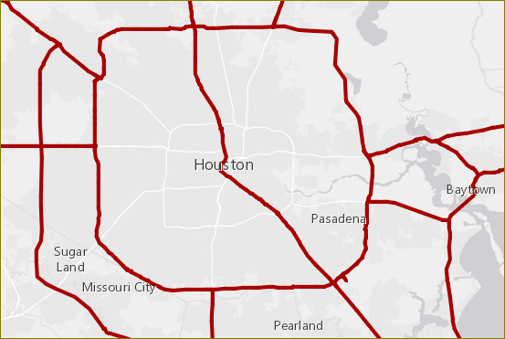
Add Demographic Data
First, you'll add a layer containing demographic data by census tract. United States census tracts divide counties into smaller geographic areas, which are useful for revealing spatial patterns.
Sign In: https://www.arcgis.com/home/index.html
1. Login and click ‘Content’
2. Click the saved map name.
3. Click ‘Open in Map Viewer’
4. Click ‘Add’, choose ‘ArcGIS Online’ and type in ‘Houston Demographics owner:Learn_ArcGIS’
5. Add the layer, ‘Houston Demographics by Census Tracts’ to the map.
6. Click back arrow and then on ‘Details | Content’
7. Click and drag “Hurricane Evacuation Routes” to top.
Next: View Attribute Table

Slide 10
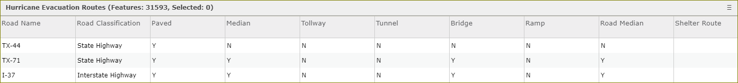
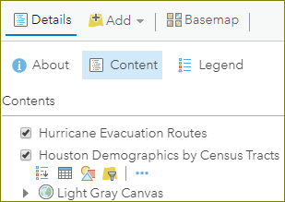
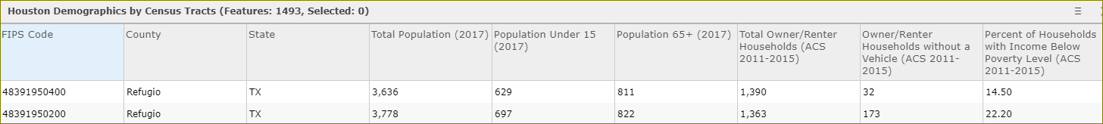
View Attribute Table
Every layer has a table that contains all attribute data about the geographic features in the layer. You'll view the table for the Houston Demographics by Census Tracts layer to find data that will help you identify areas that are vulnerable during a hurricane.
1. Click ‘Details | Content’
2. Click the layer name in the contents box.
3. Click the table icon.
Next: Style the layer with attribute

Slide 11
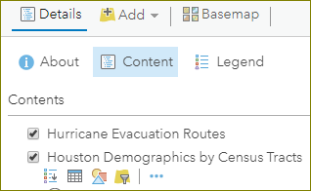
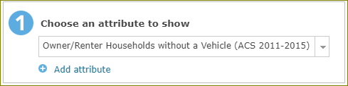
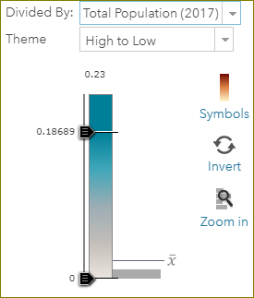
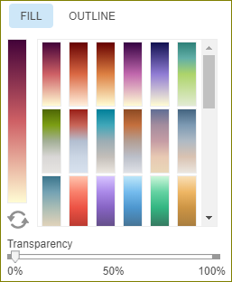
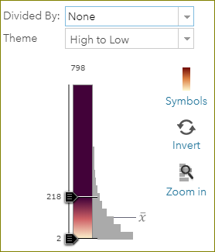
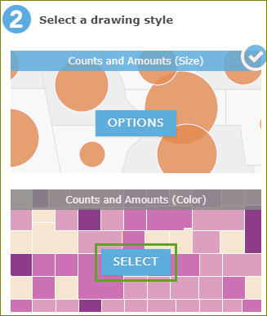
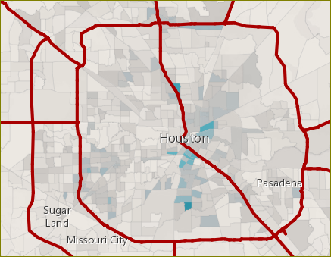
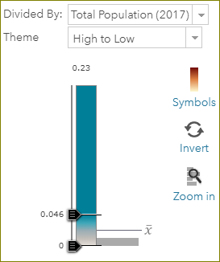
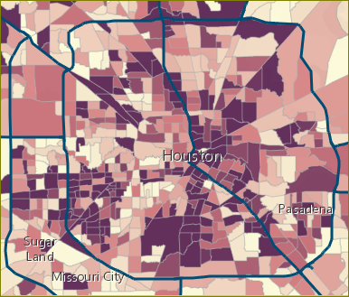
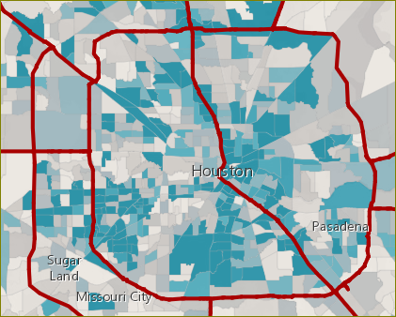
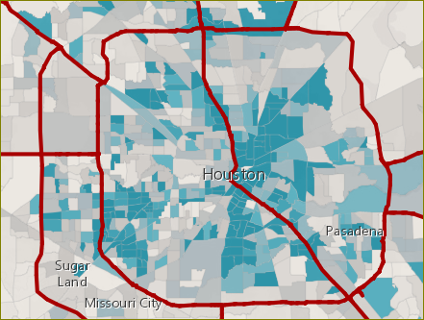
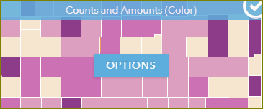
Style the Layer with Attribute
The values in the attribute tables can be applied to the layer. For instance, demography data can be displayed as color coded as in e.g. the number of households in a county. In this exercise we will show the number of households without a vehicle. Based on this data it will be possible to determine the areas that require other forms of transport for the evacuation.
1. Click ‘Details | Contents | Layer name | Change style’
5. Choose ‘Divided by: Total population (2017)’
2. Choose an attribute to show.
- Owner/Renter households wthout a vehicle
6. Slide the color bar up and down.
3. Click ‘Select’ on ‘Counts and Amounts (Color)’ (second box)
4. Click ‘Options’ on the same box
- Click ‘Symbols’ on the popup box to select colors
- Choose a color pattern.
Next: Style with normalised value

Slide 12













Style with normalised value
Currently, the layer is styled to show the total number of households without a vehicle in each census tract. However, it's possible that tracts with a higher population in general are the only ones being emphasized on the map. It'll be more meaningful for the city to concentrate assistance in tracts with a high percentage of households without a vehicle based on the total population. This percentage is called a normalized value.
1. Click ‘Details | Contents | Layer | Change Style’
2. Click ‘New Expression’
3. Click ‘Edit’ and give a title. Click ‘Save’
4. Click ‘Globals|$feature[“OwnerRenterHH_NoVehicle”]’
5. Type a ‘/’ at the end and then click ‘Globals|$feature[“OwnerRenter_HHs”]. Click ‘Test’
6. Round the result by adding ‘round((…)*100,2)’ to the expression. Click ‘Test’
7. Click ‘OK’
Next: Customise the Pop-up

Slide 13












Customise the Pop-up
Like the Hurricane Evacuation Routes layer, the Households Without a Vehicle layer has preconfigured pop-ups. However, the layer's pop-up was configured to show only total values of households without a vehicle, not percentages. Because you styled the layer with percentages, you'll customize the pop-up to show similar information.
1. Click on a tract to see the pop-up
2. Click the X to dismiss the pop-up
3. Click ‘Details | More Options’
4. Click ‘Configure Pop-up’
5. Click ‘Add’
6. Click ‘Existing’ and choose an expression. Press OK
7. Click ‘CONFIGURE’
8. Enter the expression and text to follow. Press OK
9. Click OK on a Configure Pop-up window.
10. Click on a tract to see the pop-up
Next: Interactive Web App

Slide 14









Create a Web App
A web app is a customized user interface that enhances your map's appearance, adds (or removes) functionality, and helps you integrate the map with other media. You can choose from a variety of configurable templates, depending on how you want to display your map. You simply want to showcase your map to the public, so you'll configure a Basic Viewer app template with only a few standard navigation tools.
1. Click on ‘Share’
2. Click ‘Create a web app’
3. Choose a template
4. Click ‘Create web app’
5. Enter title, keyword tags and summary.
6. Click ‘Done’ and wait until map is generated.
7. Click ‘Save’
8. Click ‘Launch’
9. Copy the URL for sharing.
Next: Advanced Usage of ArcGIS Online
https://www.arcgis.com/apps/Directions/index.html?appid=258ba08dfe2c422ca37e76c83d50834f

Slide 15
Advanced Usage of ArcGIS Online
While a facility to add GSKY Web Map Service into ArcGIS is an important step towards wider usage of the service, providing pre-created examples to demonstrate the use of GSKY may attract the users even better.
In the tutorial given above, we have seen how to create a “Web App” that is free-standing and can be accessed through the web. The Web App, however, is static and cannot be changed by the user.
In this next section we will show how data can be published so that a user can create their own maps. Such data may include map layers as well as accessory data.
The power of ArcGIS is in the facility to share pre-defined maps and associate date as free-standing projects for the world to see. To create a project one needs an ANUPublisher Account. You may be able to get it by requesting through the service portal. It is unsure whether ANUPublisher accounts will be given out to anyone outside the Fenner School of Environment and Society (FSES) who manages the ESRI Australia accounts for the ANU. It may be required to speak first to a contact given below.
FSES Contacts:
Brendan Meyer
02 6125 0349
brendan.meyer@anu.edu.au
Bruce Doran
02 6125 3704
Bruce.Doran@anu.edu.au
Phil Greaves
02 6125 4374
phil.greaves@anu.edu.au
John Boland
02 6125 4473
john.boland@anu.edu.au
What is ArcGIS Online?
ArcGIS Online is a web-based GIS that makes geographic content and analysis accessible to your entire organization. These resources can be made available to members of the organization or the general public. Because the content is hosted on the web, it can be accessed any time on any device, or even integrated with other enterprise software, such as Microsoft Office. In addition to simply providing existing content, members of the organization can add and create new content to host on the site. Members, executives, field crews, or even the community can complete their own analyses and create their own content. [^{Ref}]
Next:

Slide 16




Using ArcGIS Online with GSKY
In this section we will show how to display GSKY Web Map Service (WMS) in ArcGIS Online.
It is assumed that you have an ArcGIS Online account. If not, see slide 5 to sign-up for one.
STEPS
Login to ArcGIS Online
Click on ‘Map’ and then on ‘SIGN IN’
Choose a sign in method…
ArcGIS Login – if you have a personal account.
Enterprise login – if you have an institutional account.
Facebook or Google – These do not work. Needs further study.
Next: Create a Map and add GSKY Layers

Slide 17



Add GSKY Layers
Click ‘Add’ and select ‘Add Layer from Web’
Choose ‘A WMS OGC Web Service’
Enter the GSKY end point URL.
Click ‘Add Custom Parameters’
Click ‘Add Parameter’
Type ‘time’ under Parameter’
Type date in UTC format.
Click ‘Layer Only’
Click ‘Get Layers’
Next: Select Layers

Slide 18



Add GSKY Layers (Contd…)
Click ‘Layers’ to uncheck all layers.
Check required layers alone.
Or, click ‘Layers’ again to check all layers (preferred).
Click ‘ADD LAYER’
Next: KML method

Slide 19


The KML Method - DEA
In this section we will show how to display GSKY layers via KML in ArcGIS Online.
It is assumed that you have an ArcGIS Online account. If not, see slide 5 to sign-up for one.
STEPS
Login to ArcGIS Online (see slide 16 for details)
Click on ‘Map’ and then on ‘SIGN IN’
Choose a sign in method…
ArcGIS Login – if you have created a personal account.
Enterprise login – if you have an institutional account.
Facebook or Google – These do not seem to work.
Create the KML (DEA)
Open the wrapper web page.
Choose from the dropdown lists…
A layer (e.g. 16-day LS8 Surface Reflectance)
Date (only a single date can be selected)
Region (e.g. Australia, NSW, ACT, etc.)
Method (“Directly from GSKY” or “From Cached Tiles”)
Resolution (Low, Medium or High)
Click ‘Create KML’
Depending on the size of bounding box and resolution, it can take a few seconds to a few minutes.
Click ‘Copy the URL’
Go back to the ArcGIS Online page.
Click ‘Add | Add Layer from Web | A KML File’ and paste the URL.
Click ‘Add Layer’
Depending on the size of bounding box and resolution, it can take a few seconds to a few minutes.
Next: Advanced Usage

Slide 20


The KML Method – DEA (Contd…)
In this section we show how to define a region.
Bounding Box method
Crosshair method
Draw a bounding box
Click the Bbox icon
Click the rectangle drawing tool
Draw a rectangle
Click the paste button
Crosshair method
Move the map until the crosshair is at the required position.
Select the number of tiles
Click the crosshair button
Follow the steps 3-7 on previous slide.
Next: GEOGLAM

Slide 21




The KML Method - GEOGLAM
In this section we will show how to display GSKY layers via KML in ArcGIS Online.
It is assumed that you have an ArcGIS Online account. If not, see slide 5 to sign-up for one.
STEPS
Login to ArcGIS Online (see slide 16 for details)
Click on ‘Map’ and then on ‘SIGN IN’
Choose a sign in method…
ArcGIS Login – if you have created a personal account.
Enterprise login – if you have an institutional account.
Facebook or Google – These do not seem to work.
Create the KML (DEA)
Open the wrapper web page.
Choose from the dropdown lists…
A layer (e.g. 16-day LS8 Surface Reflectance)
Date (multiple dates can be selected)
Region (e.g. Australia, NSW, ACT, etc.)
Click ‘Create KML’
Click ‘Copy the URL’
Go back to the ArcGIS Online page.
Click ‘Add | Add Layer from Web | A KML File’ and paste the URL.
Click ‘Add Layer’
See slide 20 for drawing a bounding box.
Crosshair method does not work with GEOGLAM.
Next: Technical Details

Slide 22




The KML Method – GEOGLAM - Technical
SUMMARY
ArcGIS Online provides a facility to import a KML file, just like Google Earth. There are some differences in the behaviour between these clients.
GE displays the layers aligned with the continent boundaries.
ArcGIS shows a gap around the top of the continent. This has been corrected in the code (see below).
GE automatically zooms to the required location and zoom level.
ArcGIS may need manual panning and zooming.
Offsetting the latitudes (North and South) by 1 degree aligns it somewhat but still not exactly. This kind of mis-alignment appears to be different for Australia as compared to other regions. USA and Europe, for example, require an offset in the other direction (i.e. -1 degree). It is an anomaly of ArcGIS that we cannot control.
PROCESS FLOW
To create the KMLs an external interface is used. We cannot incorporate this interface into the ArcGIS Online page but we can embed their page into ours (strange that they haven’t disabled it!).
The interface is an AJAX (Asynchronous JavaScript and XML) driven, simple web page that takes the input and passes to a CGI (Common Gateway Interface) on the server. The CGI creates a KML (Keyhole Markup Language) file, saves on the server and sends its URL back to the web page. A public website is required for this. The VMs in NCI network will not do.
The user copies this URL and pastes it into the ArcGIS input fields. One can either open the ArcGIS page in a separate browser tab or use the embedded page.
Multiple dates can be selected, to create a single KML, or a number of KMLs with single dates can be created and imported into ArcGIS. The dates and layers can be turned ON/OFF individually. Hence, it is possible to superimpose layers or view changes over time. With a good video capturing tool one can even create a movie of changing coverages.
Data comes from the production GSKY server at https://gsky.nci.org.au/ows/geoglam
Next: Code Details

Slide 23

The KML Method – GEOGLAM – Code Details
This slide is for programmers’ information. Must view the HTML/JS/CGI for complete code.
The web interface is in plain HTML and uses AJAX to communicate with the server.
The CGI is in Perl.
Salient code snippets are given below and explained.
Working knowledge in HTML, Perl, JavaScript and AJAX is required.
Web
AJAX
CGI
Web
ArcGIS
Input Form:
<form id="arcgis_geoglam" name="arcgis_geoglam">
<select name="layer" onchange="InsertTimes(this)">
<option value="modis_fract_cov_8day|Fractional Cover 8 Day">Fractional Cover 8 Day</option>
…
</select>
<select name="region" onchange="GetCoordinates(this.form,this)">
<option value="Australia" selected="">Australia</option>
…
</select>
<select name="offset">
<option value="1" selected="selected">+1 degree</option>
</select>
<input type="text" name="bbox"> </input>
<span onmousedown="BlankBboxInputBox(document.forms.arcgis_geoglam.bbox)"><img src="images/sm_cross.png" ></span>
<img src="images/bbox_finder.png" onmousedown="ShowHideBBoxFinder(document.BBox_finder)">
<img src="images/copy_paste.png" onmousedown="GetBBoxValue(1)">
<select name="time" multiple="multiple">
<option value="2018-11-01" selected="selected">2018-11-01</Option>
…
</select>
<input type="button" value="Create KML" onclick="ValidateInput(document.forms.arcgis_geoglam,1);">
<span id="kml" style="display: none"></span>
<textarea id="copytext" style="display:none; readonly="readonly"></textarea>
<span id="copybutton" onmousedown="CopyToClipBoard()">Copy the URL</span>
</form>
Inputs and Buttons
Layer: GSKY layer name and title.
Region: Pre-set regions or ‘Unlisted’
Offset: Latitude coordinates for adjustment. Choose +1 for Australia and -1 for USA.
BBox: Bounding box coordinates in EPSG:4326. Auto filled or manually typed in.
Date: Multiple selection box. Choose one or more dates (Ctrl-click or Shift-click).
Icon (Cross): Blank the BBox input field.
Icon (Map): Open up a BBox Finder window.
Icon (Paste): Paste the BBox coordinates from the BBox Finder.
Create KML: Submit the job to a CGI and display the returned values.
Copy the URL: Copy the URL of the KML file into clipboard.
Operation
Invisible <span> elements, ‘kml’, ‘copytext’ and ‘copybutton’, are displayed upon pressing ‘Create KML’.
It will also open the ArcGIS Online page in an iFrame.
The ‘kml’ span has a link of the KML file which will be downloaded on clicking.
The text link takes the URL of the KML file into clipboard.
Readonly ‘copytext’ is essential for it to work and it must not be set as hidden.
Next: JavaScript and AJAX

Slide 24
The KML Method – GEOGLAM – Code Details
This slide is for programmers’ information.
JavaScript and AJAX
Clicking ‘Create KML’ sends a call to JavaScript as… ‘ValidateInput(document.forms.arcgis_geoglam,1)’
function ValidateInput(form,n)
{
document.getElementById("kml").innerHTML = " src=\"images/ajax-loader.gif\"> Fetching...
<input type=\"button\" value=\"Cancel\" onclick=\"CancelJob(this.form)\">";
ajaxFunction(n,form);
}
function ajaxFunction(n,form,item)
{
xmlHttp=new XMLHttpRequest();
…
if (n == 1)
{
var times = [];
for ( var i = 0; i < form.time.selectedOptions.length; i++)
{ times[i] = form.time.selectedOptions[i].value; }
pquery = "wmsclient=" + form.wmsclient.value + "&offset=" … "&layer=" + form.layer.value … + "&time=" + times;
var ran_number= Math.random()*5000;
url = cgi + "?GEOGLAM+" + ran_number + "+" + pquery;
}
if (url)
{
xmlHttp.open("GET",url,true);
xmlHttp.send(null);
}
}
Constructed URL: https://.../cgi-bin/arcgis.cgi?GEOGLAM+ran_number+wmsclient=arcgis&offset=+1&layer=name|title&region=AU&west=112.324219&south=-44.087585&east=153.984375&north=-10.919618&time=2018-11-01
function ajaxFunction(n,form,item)
{
if (xmlHttp.readyState==4)
{
response = xmlHttp.responseText;
if (n == 1) // Process the response
{
var str = response.split('"');
document.getElementById("kml").innerHTML = response;
document.getElementById("copytext").innerHTML = str[1];
showHide("kml", 'span', "block");
showHide("copytext", 'textarea', "block");
copybutton.style.color = '#0000FF';
showHide("copybutton", 'span', "block");
showHide("arcgis_window",'iframe',"none");
showHide('bbox_finder','div','none');
showHide('top_section','div','none');
showHide('Details','div','none');
showHide("help", 'span', "block");
}
}
…
}
Function ValidateInput:
This function name is historical and does not do any validation of the data. All that it does is display a waiting message and call an AJAX function.
Function ajaxFunction:
Takes the input fields from the web form, constructs a URL and sends it as ‘method=GET’ to the CGI. If the URL is the same from a previous call, as happens if the same layer and date(s) are chosen, the browser will consider it as cached data and not send it to the CGI. To prevent this, a random number is inserted in the URL.
Response from the CGI is processed and displayed on the web page.
Next: The CGI

Slide 25
The KML Method – GEOGLAM – Code Details
This slide is for programmers’ information.
arcgis.cgi
if ($time =~ /,/)
{
# This is a multiple dates selection
CreateMultipleKML;
$outfile = $region . "_" . $basetitle . "_" . $$ . ".kml";
$outfile =~ s/ /_/gi;
open (OUT, ">$kmlDir/$outfile");
print OUT $kml;
close(OUT);
print "<small><a href=\"$url/$outfile\">$outfile</a></small>";
}
else
{
# This is a single date selection
$date = $time;
$date =~ s/T.*//g;
if ($time)
{
$time="TIME=$time";
}
$title = $region . "_" . $basetitle . " " . $date;
CreateSingleKML;
$outfile = $region . "_" . $basetitle . "_" . $$ . "_" . $date . ".kml";
$outfile =~ s/ /_/gi;
open (OUT, ">$kmlDir/$outfile");
close(OUT);
print "<small><a href=\"$url/$outfile\">$outfile</a></small>";
}
exit;
sub CreateMultipleKML
{
$north_adjusted = $north+$offset;
$south_adjusted = $south+$offset;
$visibility = 1; # Set this to 0 after the first layer.
my @times = split(/,/, $time);
my $len = $#times;
for (my $j=0; $j <= $len; $j++)
{
$date = $times[$j];
$date =~ s/T.*Z//gi;
$title = $region . "_" . $basetitle . " " . $date;
$time = "";
if($times[$j]) { $time="TIME=$times[$j]"; }
GroundOverlay;
$visibility = 0;
}
$kml = "<?xml version=\"1.0\" encoding=\"UTF-8\"?>
<kml xmlns=\"http://www.opengis.net/kml/2.2\" xmlns:gx=\"http://www.google.com/kml/ext/2.2\" xmlns:kml=\"http://www.opengis.net/kml/2.2\" xmlns:atom=\"http://www.w3.org/2005/Atom\">
<Document>
<name>$layer</name>
$groundOverlay
</Document>
</kml>
";
}
sub CreateSingleKML
{
$north_adjusted = $north+$offset;
$south_adjusted = $south+$offset;
$kml = "<?xml version=\"1.0\" encoding=\"UTF-8\"?>
<kml xmlns=\"http://www.opengis.net/kml/2.2\" xmlns:gx=\"http://www.google.com/kml/ext/2.2\" xmlns:kml=\"http://www.opengis.net/kml/2.2\" xmlns:atom=\"http://www.w3.org/2005/Atom\">
<GroundOverlay>
<name>$date</name>
<visibility>1</visibility>
<Icon>
<href>
$gskyUrl?SERVICE=WMS&amp;VERSION=1.1.1&amp;REQUEST=GetMap&amp;SRS=EPSG:4326&amp;WIDTH=512&amp;HEIGHT=512&amp;LAYERS=$layer&amp;STYLES=&amp;TRANSPARENT=TRUE&amp;FORMAT=image/png&amp;BBOX=$west,$south,$east,$north&amp;$time
</href>
</Icon>
<LatLonBox>
<north>$north_adjusted</north>
<south>$south_adjusted</south>
<east>$east</east>
<west>$west</west>
</LatLonBox>
</GroundOverlay>
</kml>
";
}
Single and multiple dates differ in the structure of the KML file. The ‘function GroundOverlay’ is repeatedly called for creating the multiple dates, whereas it is included in the single date call. Spaces and tabbing in the output text are for aesthetics of the resulting KML file. Do not alter them in the CGI.
ArcGIS caches the URL and, to prevent it, a random number (the process ID) is inserted.
If the CGI is run as an unprivileged user (e.g. ‘apache’) the output directory ($kmlDir) must have appropriate permissions or ownership by the user.
Next: Supported KML Functions

Slide 26
Supported KML functionalities
Supported functionality [Ref]
Map Viewer supports a subset of KML elements and functionality.
(Only those in blue are implemented in ArcGiSKY)
Placemarks
Network links to import data dynamically
Ground overlays
Folders
Polylines and polygons
Styles of polylines and polygons, including colour, fill, and opacity
Print KML layer
Icons
Descriptive HTML
KMZ (compressed KML, including attached images)
Embed KML layer in website
ExtendedData in pop-up descriptions
Network links with refresh parameters
KML icons with hotSpot nodes
KML was originally created to view features in three-dimensional Earth browsers such as ArcGIS Earth. KML is now supported in a number of two-dimensional web browser clients, including Map Viewer. There are some aspects of KML that do not work well on 2D screens and some limitations to what web browser clients can support.
Next: KML Limitations in ArcGIS

Slide 27
KML Limitations in ArcGIS Online
Limitations
The current limitations of using KML layers in Map Viewer are as follows:
(None of these limitations affects ArcGiSKY)
The following elements do not display in a map: regionated KML, view-based and time-based refresh parameters, regions inside network links, and screen overlays.
Ground overlays and network links without refresh properties do not print.
Image overlays that cover large areas may appear distorted.
By default, there is a 30-minute cache delay in displaying updates to the KML layer. If the layer contains refresh parameters of less than 30 minutes, the shorter interval is honored. If a refresh interval is set on the layer, the refresh interval is honored.
KML layers cannot be used as a basemap.
You cannot set the visibility range for KML layers.
KML layers cannot be reordered in the map contents.
Internal KML layers are not supported.
Configuring pop-ups is not supported in KML layers. Any feature data in the layer is automatically displayed in pop-ups; you cannot configure or disable them.
KML layers larger than 10 MB cannot be added to maps.
Next: Comparisons

Slide 28
Comparisons
The KMLs created with ArcGiSKY can be displayed in various clients. Given below is a comparison in four clients.
Features | ArcGIS Online | ArcGIS Explorer | ArcGIS Earth | Google Earth
KML File | Yes | Yes | Yes | Yes
KML on public webserver | Yes | Yes | Yes | No
Works on VM server | No | Yes | Yes | Yes
Native WMS feature | Yes* | Yes** | Yes** | No
KML on Google Drive | No | No | No | Yes
Distortion in 2D Map | Yes | Yes | NA | NA
Normal display in 3D | NA | Yes | Yes | Yes
* No display until high zoom level for DEA. No date selection.
** No display until high zoom level for DEA. Only the topmost layer is displayed for GEOGLAM.
Next: Comparisons

Slide 29
Comparisons (Contd…)
The KMLs created with ArcGiSKY can be displayed in various clients. Given below is a comparison in four clients.
Features | ArcGIS Online | ArcGIS Explorer | ArcGIS Earth | Google Earth
Multiple Dates | Yes | Yes* | Yes* | Yes
* All dates are checked by default, even though the setting in KML is to check only the topmost. You can uncheck all and selectively check the required dates.
Next: ArcGIS Explorer

Slide 30

ArcGIS Explorer
ArcGIS Explorer lets you explore and present maps. Maps show you where things are, tell you what they are and help you understand why they are that way. ArcGIS Explorer lets you open a map, add other content to it, navigate around it, ask questions the map can answer, and present and share the map with others. If you and others in your organization work with ArcGIS Desktop products, you'll find numerous integrative and complementary uses for ArcGIS Explorer that will help you disseminate your work.
The maps you'll explore with ArcGIS Explorer may be draped on a globe or you can view them as 2D documents. You'll be able to navigate over the terrain and map and know where you are by seeing the current latitude and longitude. Also, if you've enabled it, a north arrow appears that not only serves to indicate orientation but can be made active to control pan, zoom, rotation, and tilt actions.
You can add a comprehensive set of data in numerous formats to ArcGIS Explorer, displaying the rich analytical symbology the data was created with. In addition you can control the scale at which the data display.
ArcGIS Explorer is a Windows software and will not run on Mac natively. However, you can run it under VirtualBox on Mac. See next slide for details.
Install ArcGIS Explorer 2.0.0 Build 3400
Next: View GSKY layers in ArcGIS Explorer

Slide 31

View GSKY layers in ArcGIS Explorer
ArcGIS can display layers in various ways, but only the WMS and KML ways are of importance to GSKY.
We shall examine the WMS method first. It is similar to TerriaMap, with an important difference that date selection is not possible.
HOW?
Click ‘Add Content |GIS Services…’
Choose ‘Server type: WMS’
Type in the GSKY capabilities end point URL as Server and click ‘Next’
The available layers will be shown as a list
Click the required layer(s) in the list and click ‘Add Service’
Zoom in to view the added layer.
The world view will not show the layers.
Must zoom at least one level in before the layer shows up.
Error: Irrespective of which layer is chosen, it always displays the first layer in the list. This appears to be a bug in the program or in the GSKY server. Needs further investigation!
Next: Install Windows 10 and run ArcGIS Explore under Mac OS

Slide 32

ArcGIS Explorer for Mac
VirtualBox is free and enterprise-ready virtual machine platform that allows you to run other operating systems within Mac OS X. Using VirtualBox you are able to install other operating systems into a virtual computer that can be launched and used directly within Mac OS X. This allows you to run virtually any operating system at the same time while using Mac OS X, including Windows.
When using VirtualBox, the software is installed on the host machine and then any other virtual machines are considered guests of that host. These guest virtual machines can be running a variety of different operating systems that include Windows, Linux, and MacOS.
Using a program like VirtualBox allows you to run software that only works on Windows.
Install VirtualBox on Mac and install Windows 10
Install ArcGIS Explorer 2.0.0 Build 3400
Next: End of Slides

Slide 33






Acknowledgements

